Slide 2

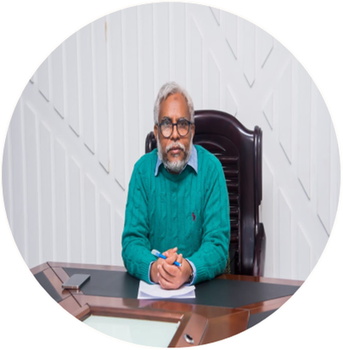
The Constitution of the People‌‌‍’s Republic of Bangladesh

Slide 3
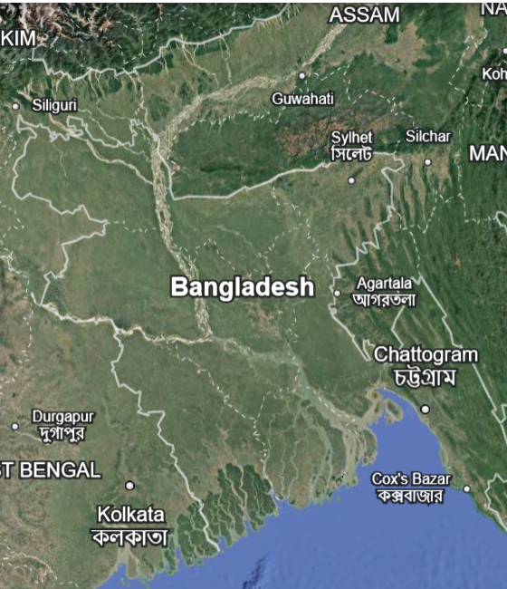
Introduction of Bangladesh Constitution and Fundamental Principles of state

Slide 4
The Constitution of Bangladesh is the supreme law of Bangladesh. The constitution was adopted by the Constituent Assembly of Bangladesh on 4 November 1972, it came into effect on 16 December 1972.

Slide 5
১৫৩ অনুচ্ছেদ
১১ ভাগ
তপসিল-০৭

Slide 6
১৫৩
অনুচ্ছেদ
১৫৩
১১
ভাগ
১১
০৭
তপসিল
০৭

Slide 7
প্রস্তাবনা
প্রজাতন্ত্র
রাষ্ট্রপরিচালনার মূল নীতি
মৌলিক অধিকার
নির্বাহী বিভাগ
আইনসভা
বিচার বিভাগ
নির্বাচন
মহা হিসাব নিরীক্ষক ও নিয়ন্ত্রক
কর্ম বিভাগ
সংবিধান সংশোধন
বিবিধ
১৫৩ অনুচ্ছেদ

Slide 8
153
Articles
11
Parts
7
Schedules

Slide 9
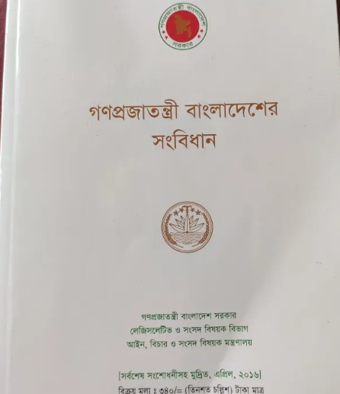
The Constitution of Bangladesh has 153 articles. It's organized into eleven parts and four schedules. These articles cover various aspects of governance, including the Republic, fundamental principles of state policy, fundamental rights, the executive, the legislature, the judiciary, and more.

Slide 10

গণপ্রজাতন্ত্রী বাংলাদেশের সংবিধান

Slide 11


Slide 12
সংবিধানের কাঠামো
প্রস্তাবনা
প্রজাতন্ত্র
রাষ্ট্র পরিচালনার মূলনীতি

Slide 13
সংবিধানের কাঠামো
মৌলিক অধিকার
নির্বাহী বিভাগ
আইনসভা

Slide 14
সংবিধানের কাঠামো
বিচার বিভাগ
নির্বাচন
মহা হিসাব নিরীক্ষক ও নিয়ন্ত্রক

Slide 15
সংবিধানের কাঠামো
কর্মবিভাগ
সংবিধান সংশোধন
বিবিধ

Slide 16
PREAMBLE
BHFP
Birth of Bangladesh
Fundamental Principle of Constitution
FACD
Fundamental Aim of State
Constitutional Duty of the People
OJEC
Object
Enacting Clause

Slide 17
BISMILLAH-AR-RAHMAN-AR-RAHIM
In the name of Allah, the Beneficient, the Merciful)/ In the name of the Creator, the Merciful.
PREAMBLE
We, the people of Bangladesh, having proclaimed our independence on the 26th day of March, 1971 and through ²[a historic struggle for national liberation], established the independent, sovereign People's Republic of Bangladesh;
Pledging that the high ideals of nationalism, socialism, democracy and secularism, which inspired our heroic people to dedicate themselves to, and our brave martyrs to sacrifice their lives in, the national liberation struggle, shall be the fundamental principles of the Constitution;]
Further pledging that it shall be a fundamental aim of the State to realise through the democratic process a socialist society, free from exploitation a society in which the rule of law, fundamental human rights and freedom, equality and justice, political, economic and social, will be secured for all citizens;
Affirming that it is our sacred duty to safeguard, protect and defend this Constitution and to maintain its supremacy as the embodiment of the will of the people of Bangladesh so that we may prosper in freedom and may make our full contribution towards international peace and co operation in keeping with the progressive aspirations of mankind;
In our Constituent Assembly, this eighteenth day of Kartick, 1379 B.S., corresponding to the fourth day of November, 1972 A.D., do hereby adopt, enact and give to ourselves this Constitution.

Slide 18
বিস্‌মিল্লাহির-রহ্‌মানির রহিম
দয়াময়, পরম দয়ালু, আল্লাহের নামে)/ পরম করুণাময় সৃষ্টিকর্তার নামে।
প্রস্তাবনা
আমরা, বাংলাদেশের জনগণ, ১৯৭১ খ্রীষ্টাব্দের মার্চ মাসের ২৬ তারিখে স্বাধীনতা ঘোষণা করিয়া ²[জাতীয় মুক্তির জন্য ঐতিহাসিক সংগ্রামের] মাধ্যমে স্বাধীন ও সার্বভৌম গণপ্রজাতন্ত্রী বাংলাদেশ প্রতিষ্ঠিত করিয়াছি;
আমরা অঙ্গীকার করিতেছি যে, যে সকল মহান আদর্শ আমাদের বীর জনগণকে জাতীয় মুক্তি সংগ্রামে আত্মনিয়োগ ও বীর শহীদদিগকে প্রাণোৎসর্গ করিতে উদ্বুদ্ধ করিয়াছিল -জাতীয়তাবাদ, সমাজতন্ত্র, গণতন্ত্র ও ধর্মনিরপেক্ষতার সেই সকল আদর্শ এই সংবিধানের মূলনীতি হইবে ;
আমরা আরও অঙ্গীকার করিতেছি যে, আমাদের রাষ্ট্রের অন্যতম মূল লক্ষ্য হইবে গণতান্ত্রিক পদ্ধতিতে এমন এক শোষণমুক্ত সমাজতান্ত্রিক সমাজের প্রতিষ্ঠা- যেখানে সকল নাগরিকের জন্য আইনের শাসন, মৌলিক মানবাধিকার এবং রাজনৈতিক, অর্থনৈতিক ও সামাজিক সাম্য, স্বাধীনতা ও সুবিচার নিশ্চিত হইবে;
আমরা দৃঢ়ভাবে ঘোষণা করিতেছি যে, আমরা যাহাতে স্বাধীন সত্তায় সমৃদ্ধি লাভ করিতে পারি এবং মানবজাতির প্রগতিশীল আশা-আকাঙ্খার সহিত সঙ্গতি রক্ষা করিয়া আন্তর্জাতিক শান্তি ও সহযোগিতার ক্ষেত্রে পূর্ণ ভূমিকা পালন করিতে পারি, সেইজন্য বাংলাদেশের জনগণের অভিপ্রায়ের অভিব্যক্তিস্বরূপ এই সংবিধানের প্রাধান্য অক্ষুণ্ন রাখা এবং ইহার রক্ষণ, সমর্থন ও নিরাপত্তাবিধান আমাদের পবিত্র কর্তব্য;
এতদ্বারা আমাদের এই গণপরিষদে, অদ্য তের শত ঊনআশী বঙ্গাব্দের কার্তিক মাসের আঠারো তারিখ, মোতাবেক ঊনিশ শত বাহাত্তর খ্রীষ্টাব্দের নভেম্বর মাসের চার তারিখে, আমরা এই সংবিধান রচনা ও বিধিবদ্ধ করিয়া সমবেতভাবে গ্রহণ করিলাম।

Slide 19
BISMILLAH-AR-RAHMAN-AR-RAHIM
(In the name of Allah, the Beneficient, the Merciful)/ In the name of the Creator, the Merciful.]
PREAMBLE
We, the people of Bangladesh, having proclaimed our independence on the 26th day of March, 1971 and through ²[a historic struggle for national liberation], established the independent, sovereign People's Republic of Bangladesh;
³[Pledging that the high ideals of nationalism, socialism, democracy and secularism, which inspired our heroic people to dedicate themselves to, and our brave martyrs to sacrifice their lives in, the national liberation struggle, shall be the fundamental principles of the Constitution;]
Further pledging that it shall be a fundamental aim of the State to realise through the democratic process a socialist society, free from exploitation a society in which the rule of law, fundamental human rights and freedom, equality and justice, political, economic and social, will be secured for all citizens;
Affirming that it is our sacred duty to safeguard, protect and defend this Constitution and to maintain its supremacy as the embodiment of the will of the people of Bangladesh so that we may prosper in freedom and may make our full contribution towards international peace and co operation in keeping with the progressive aspirations of mankind;
In our Constituent Assembly, this eighteenth day of Kartick, 1379 B.S., corresponding to the fourth day of November, 1972 A.D., do hereby adopt, enact and give to ourselves this Constitution.

Slide 20

Constitution of the United States
We the People of the United States, in Order to form a more perfect Union, establish Justice, insure domestic Tranquility, provide for the common defence, promote the general Welfare, and secure the Blessings of Liberty to ourselves and our Posterity, do ordain and establish this Constitution for the United States of America.

Slide 21

Constitution of India
WE, THE PEOPLE OF INDIA, having solemnly resolved to constitute India into a [SOVEREIGN SOCIALIST SECULAR DEMOCRATIC REPUBLIC] and to secure to all its citizens: JUSTICE, social, economic and political; LIBERTY of thought, expression, belief, faith and worship; EQUALITY of status and of opportunity; and to promote among them all FRATERNITY assuring the dignity of the individual and the 2 [unity and integrity of the Nation]; IN OUR CONSTITUENT ASSEMBLY this twenty sixth day of November, 1949, do HEREBY ADOPT, ENACT AND GIVE TO OURSELVES THIS CONSTITUTION.

Slide 22
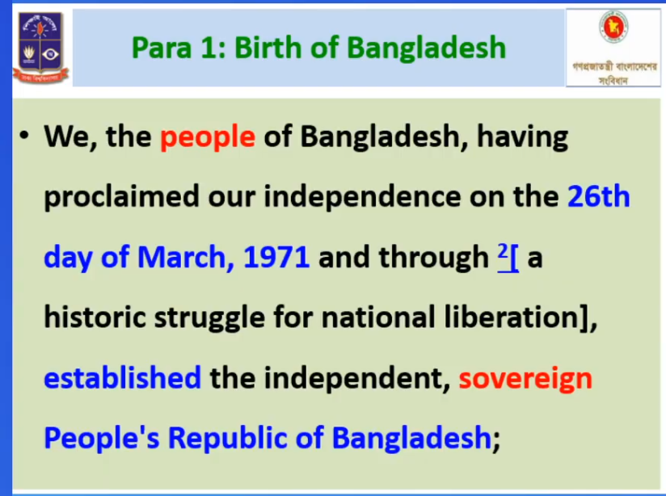

Slide 23
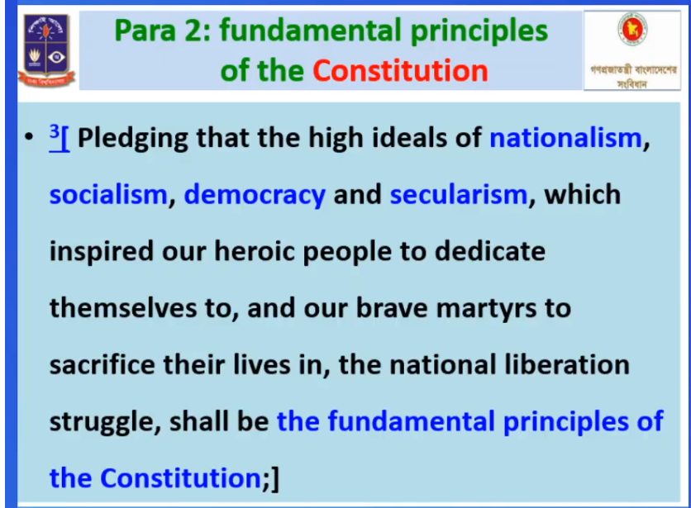

Slide 24
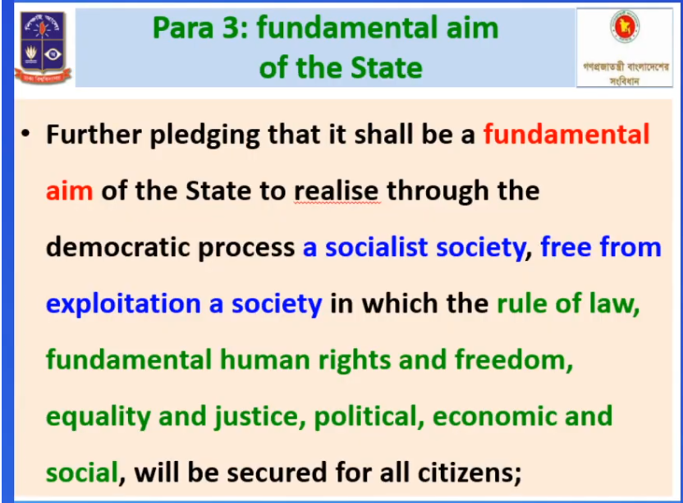

Slide 25
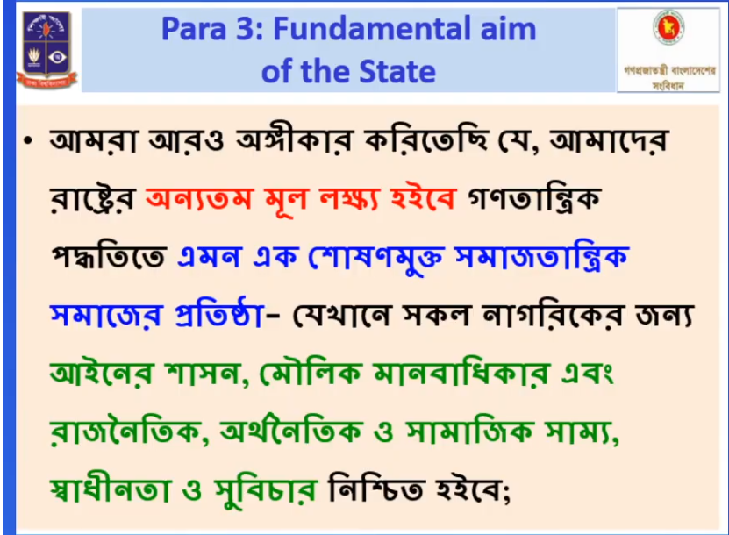

Slide 26
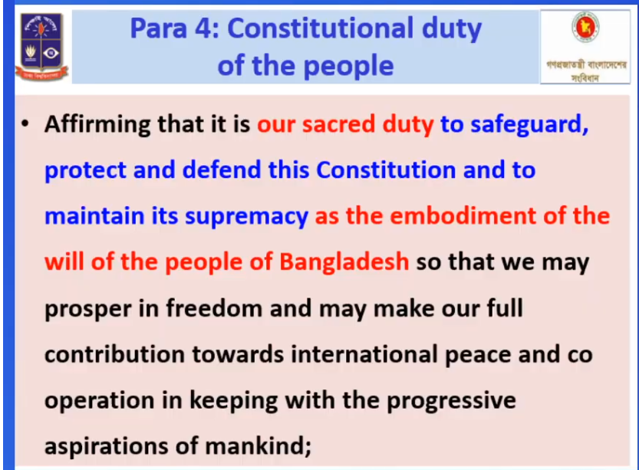

Slide 27
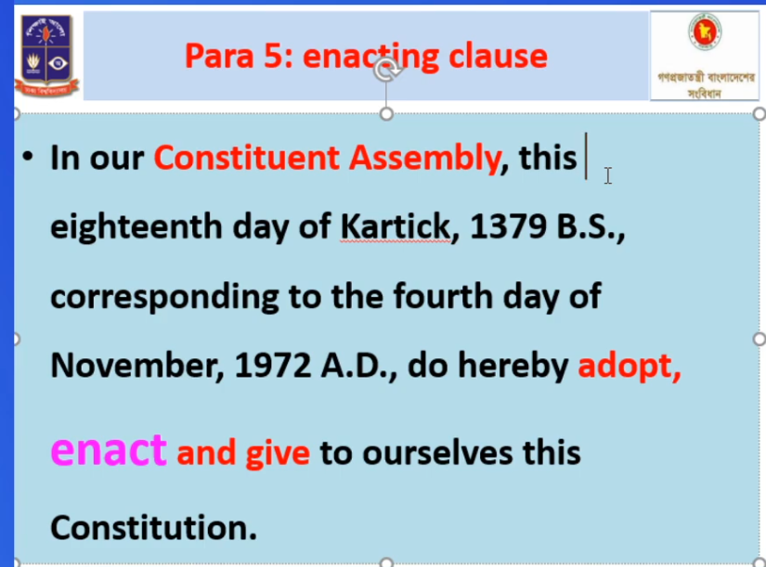

Slide 28
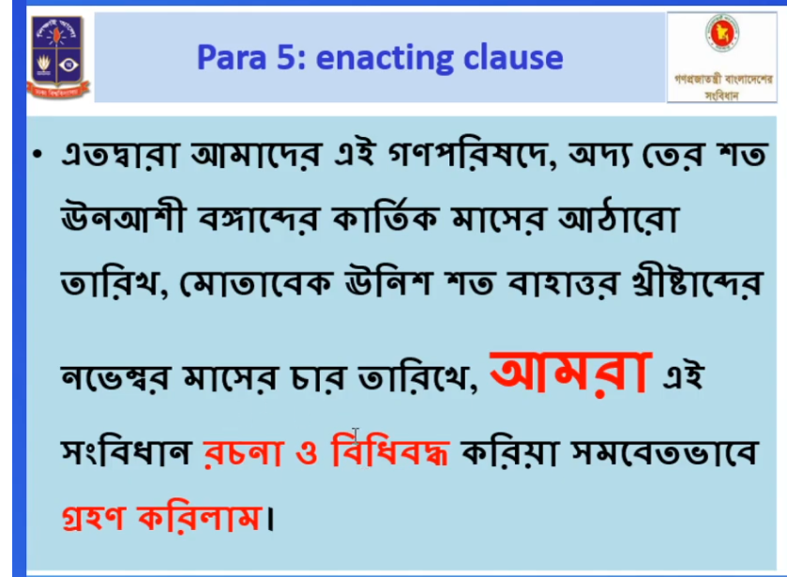

Slide 29
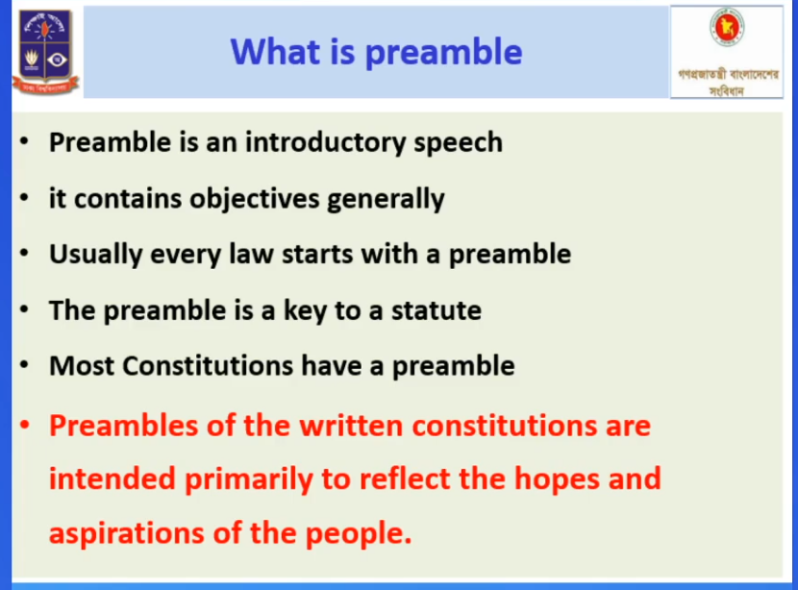

Slide 30
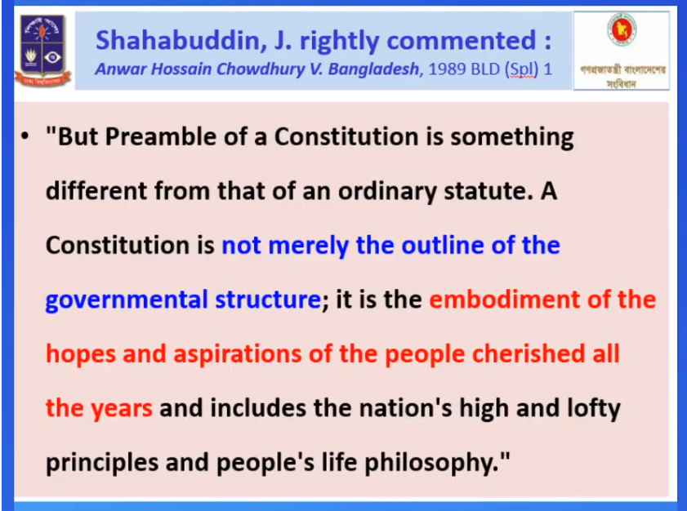

Slide 31
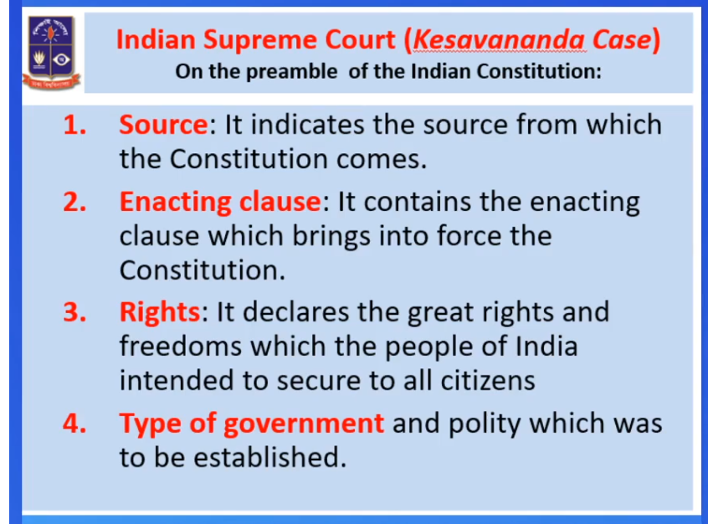

Slide 32
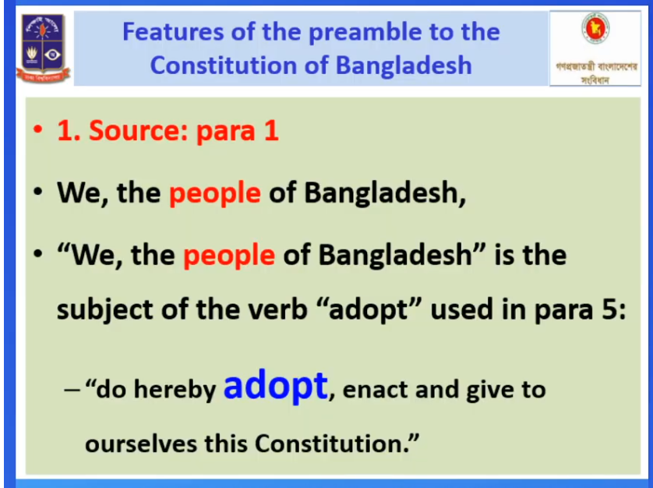

Slide 33
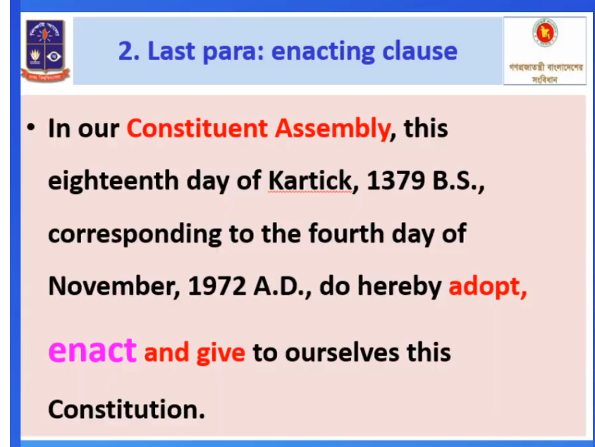

Slide 34
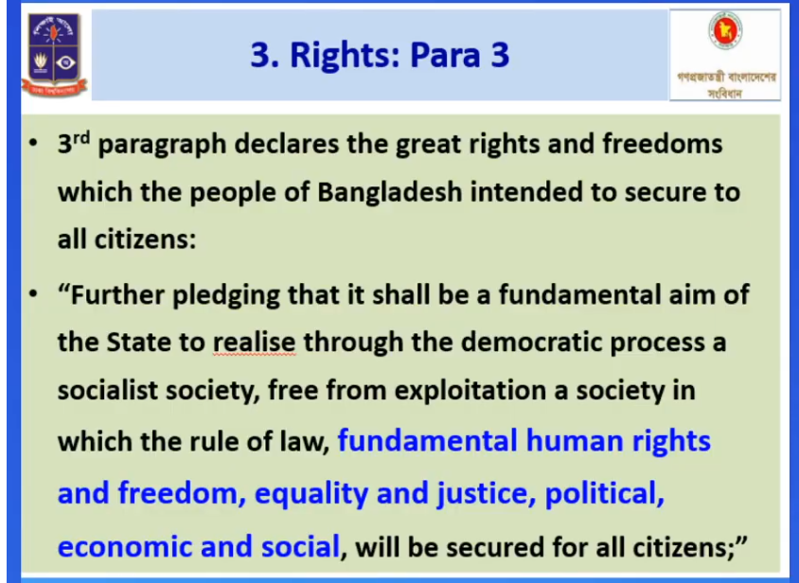

Slide 35
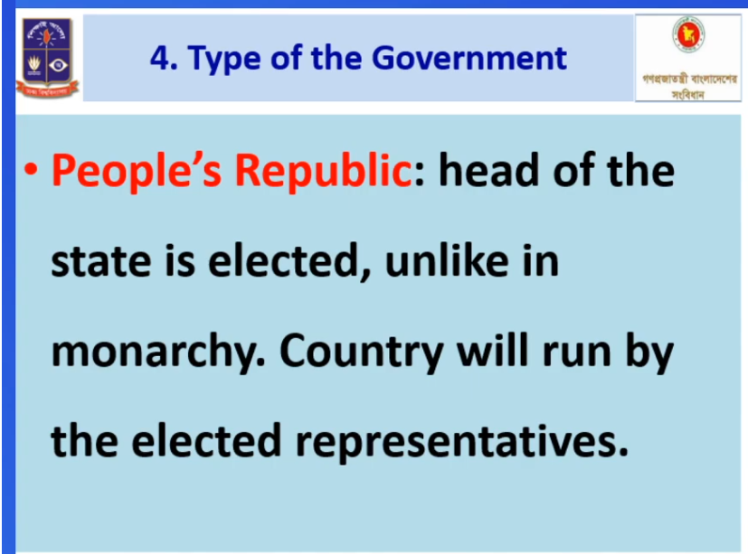

Slide 36
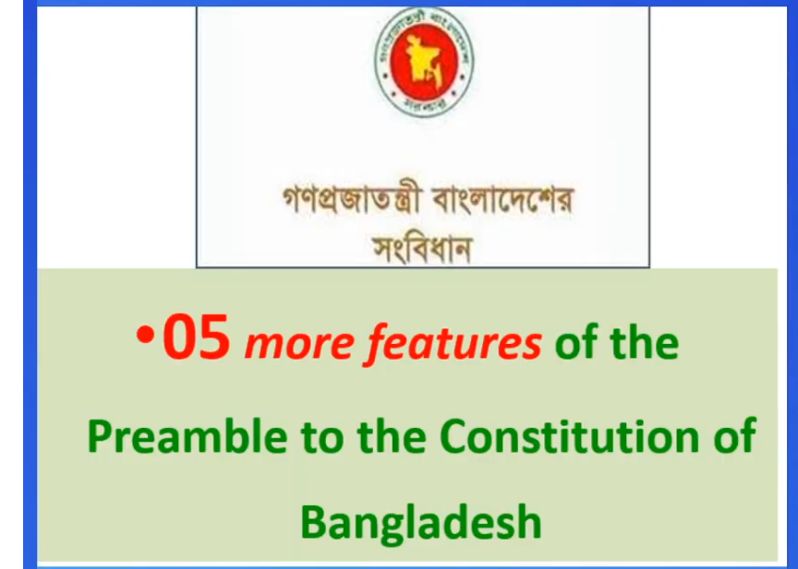

Slide 37
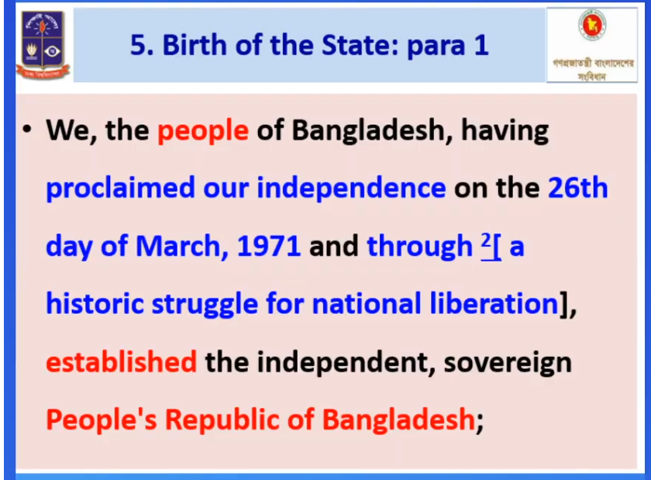

Slide 38
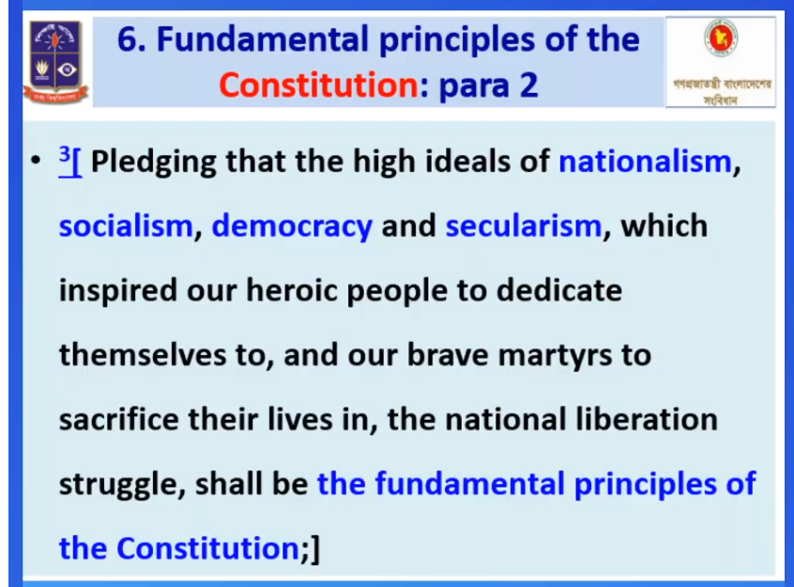

Slide 39
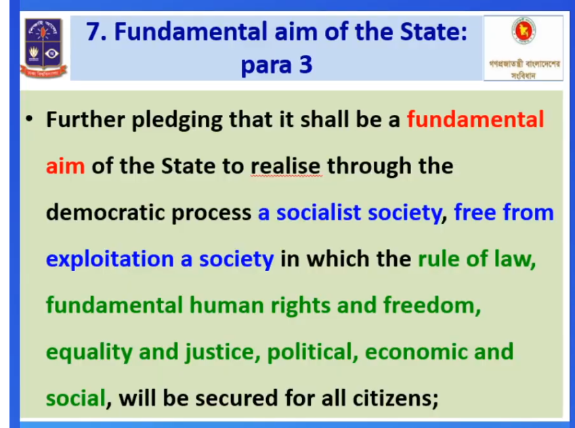

Slide 40
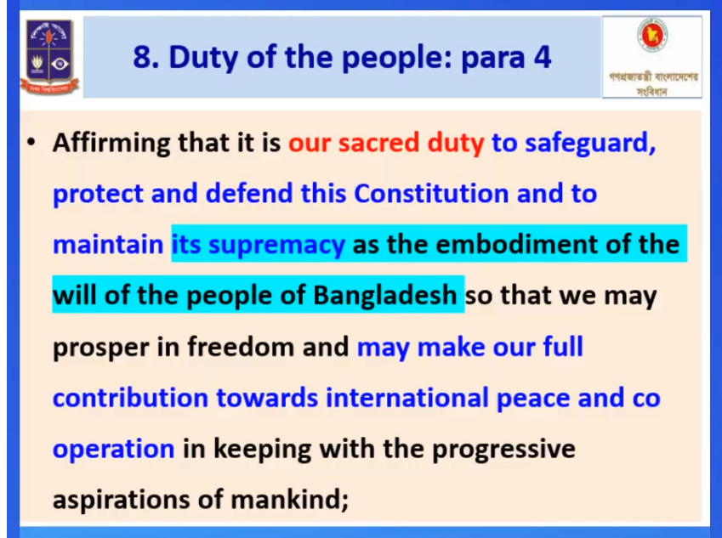

Slide 41
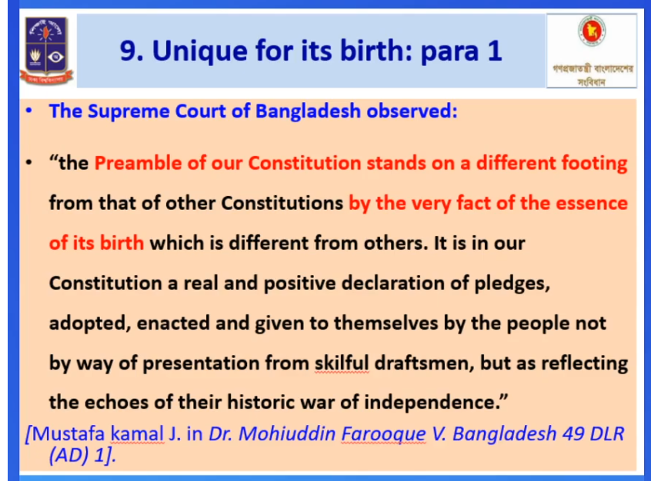

Slide 42
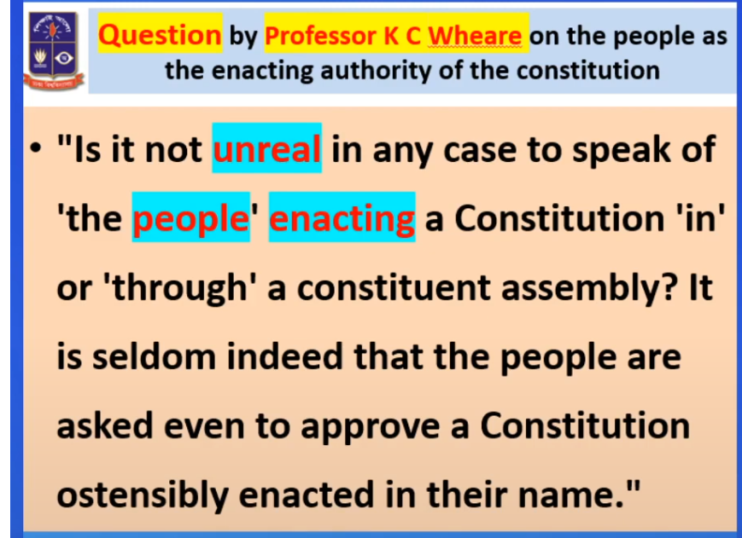

Slide 43
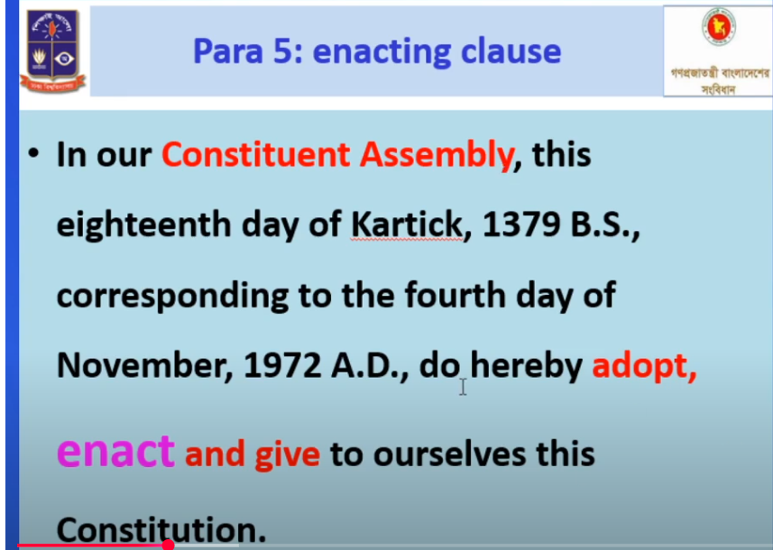

Slide 44
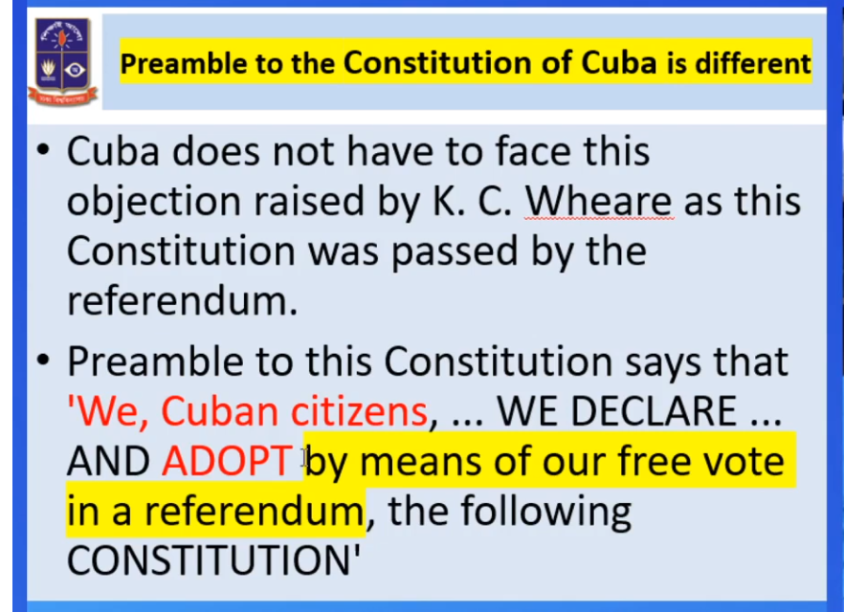

Slide 45
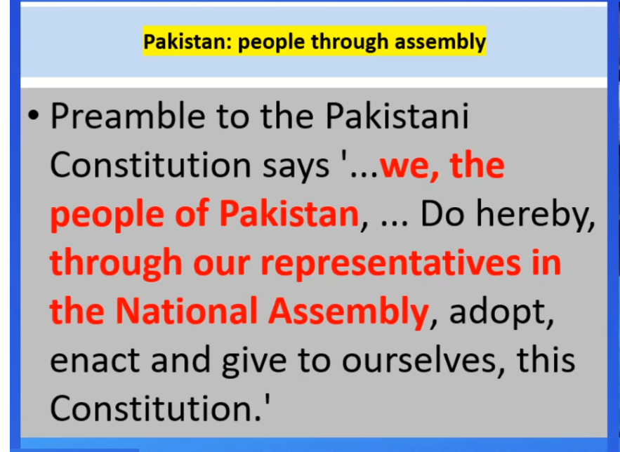

Slide 46
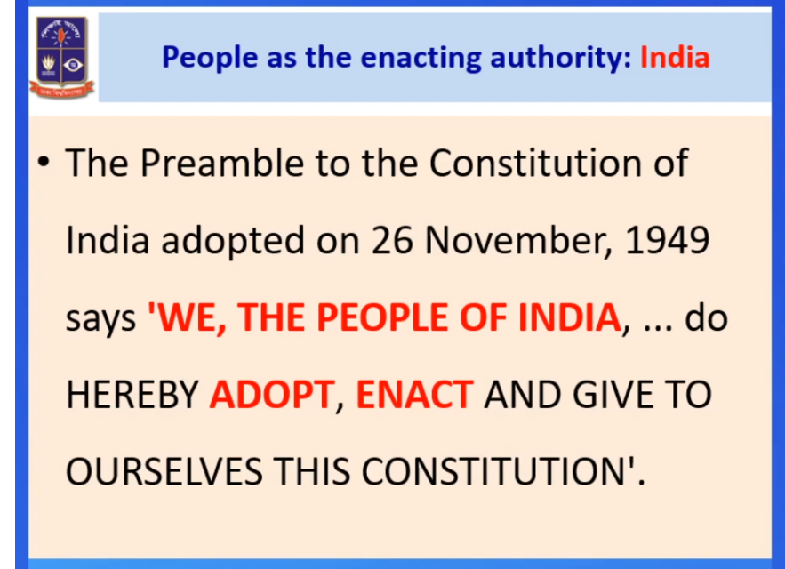

Slide 47
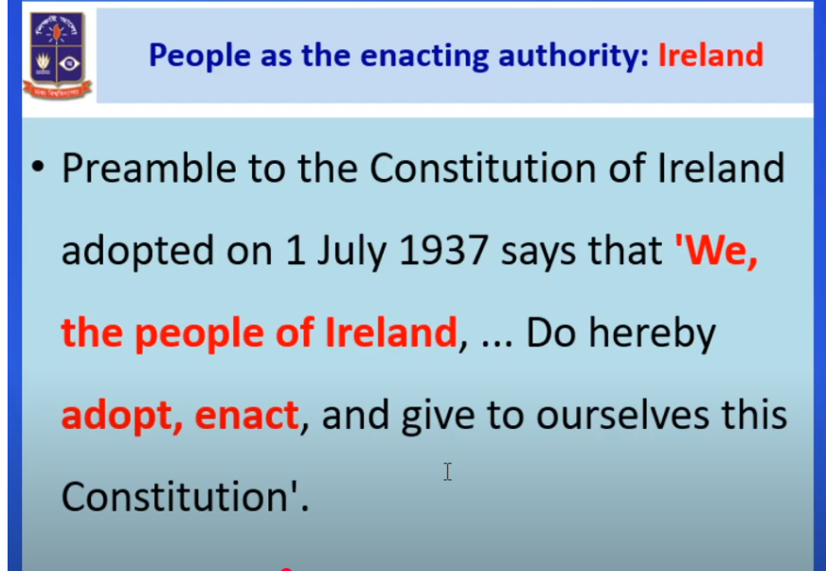

Slide 48
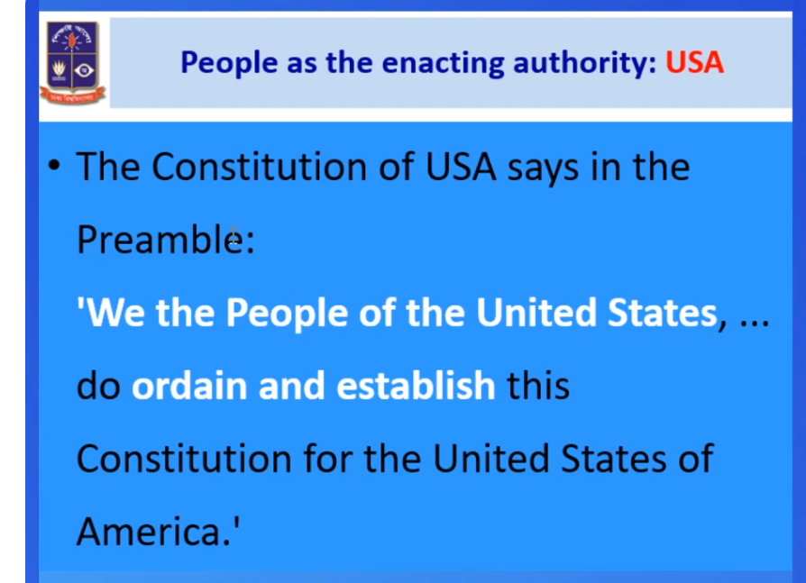

Slide 49
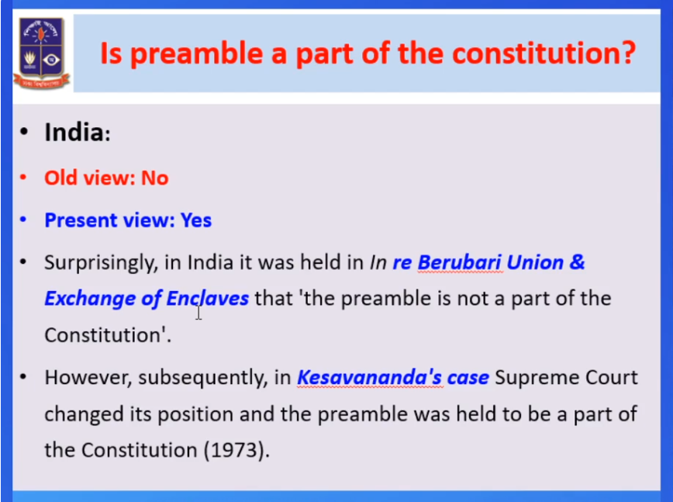

Slide 50
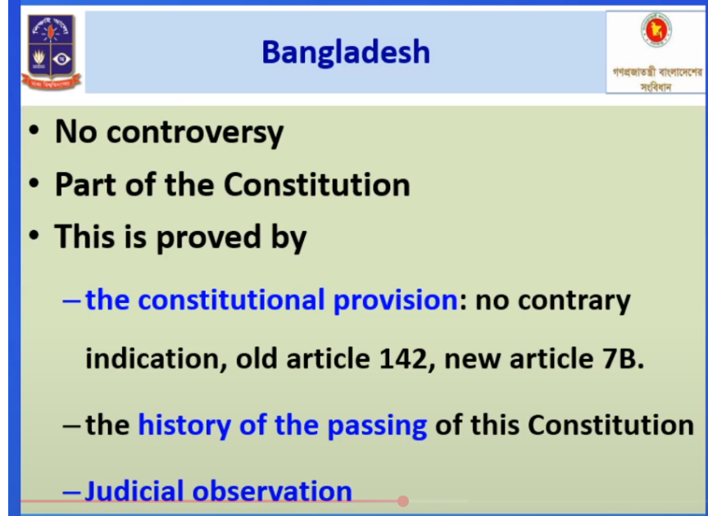

Slide 51
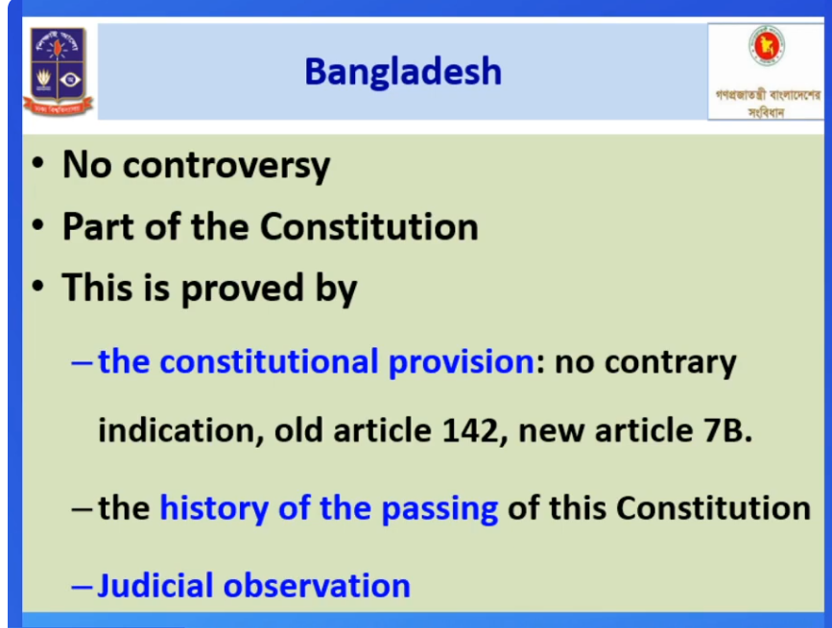
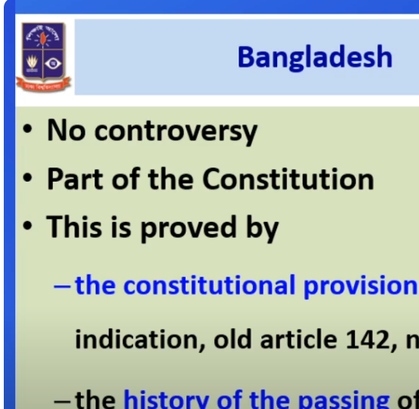

Slide 52
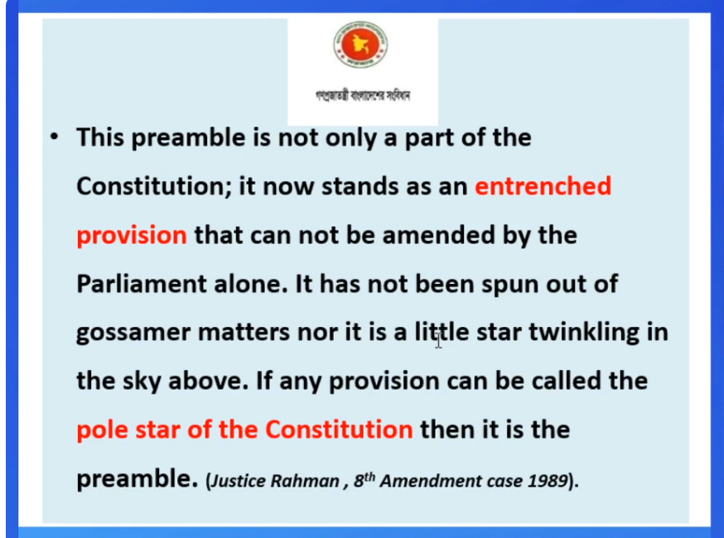

Slide 53
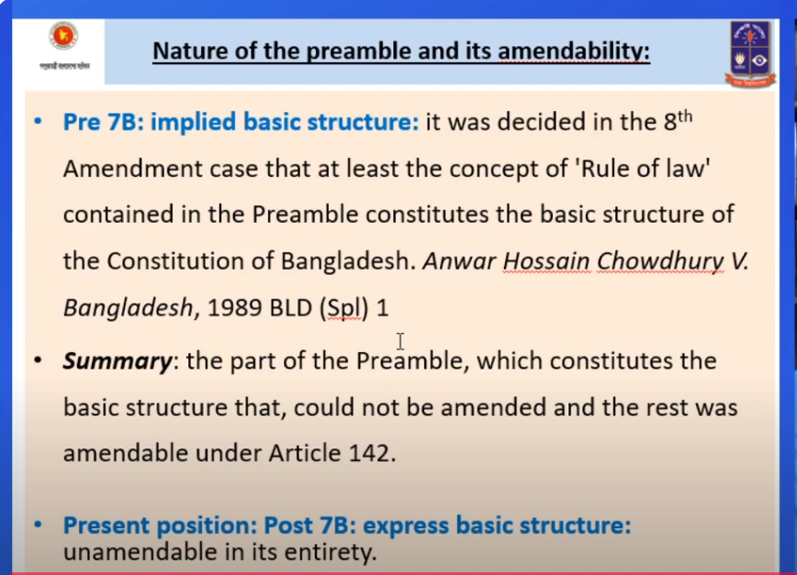

Slide 54
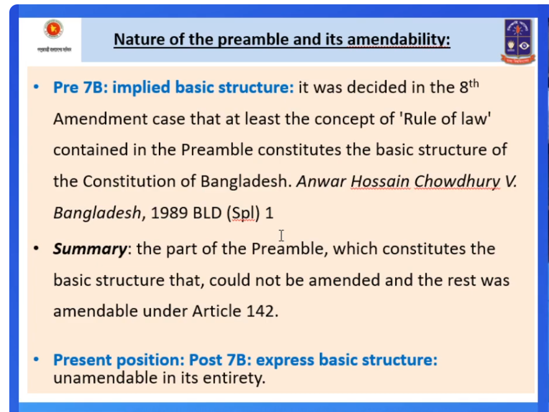

Slide 55

Part I
THE REPUBLIC
1. The Republic
2. The territory of the Republic
2A. The state religion
3. The state language
4. National anthem, flag and emblem
4A. Portrait of the Father of the Nation
5. The capital
6. Citizenship
7. Supremacy of the Constitution
7A. Offence of abrogation, suspension, etc . of the Constitution
7B. Basic provisions of the Constitution are not amendable

Slide 56
প্রজাতন্ত্র
নাগরিকত্ব
রাষ্ট্রভাষা
রাষ্ট্রধর্ম
প্রজাতন্ত্রের রাষ্ট্রীয় সীমানা
রাজধানী
জাতীয় সঙ্গীত, পতাকা ও প্রতীকপ্রতীক
জাতির পিতার প্রতিকৃতি
সংবিধান বাতিল, স্থগিতকরণ, ইত্যাদি অপরাধ
সংবিধানের প্রাধান্য
সংবিধানের মৌলিক বিধানাবলী সংশোধন অযোগ্য

Slide 57
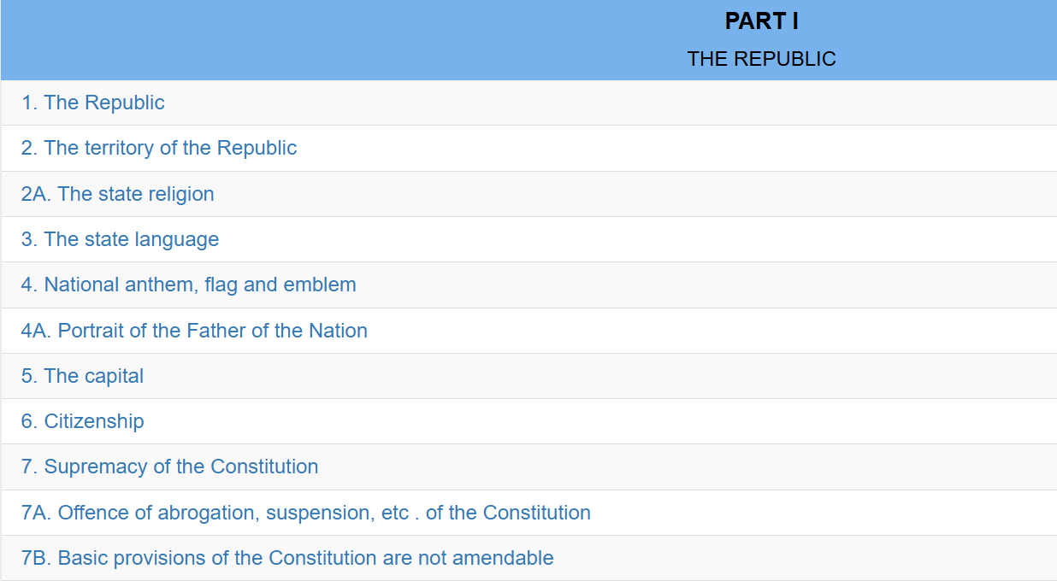

Slide 58
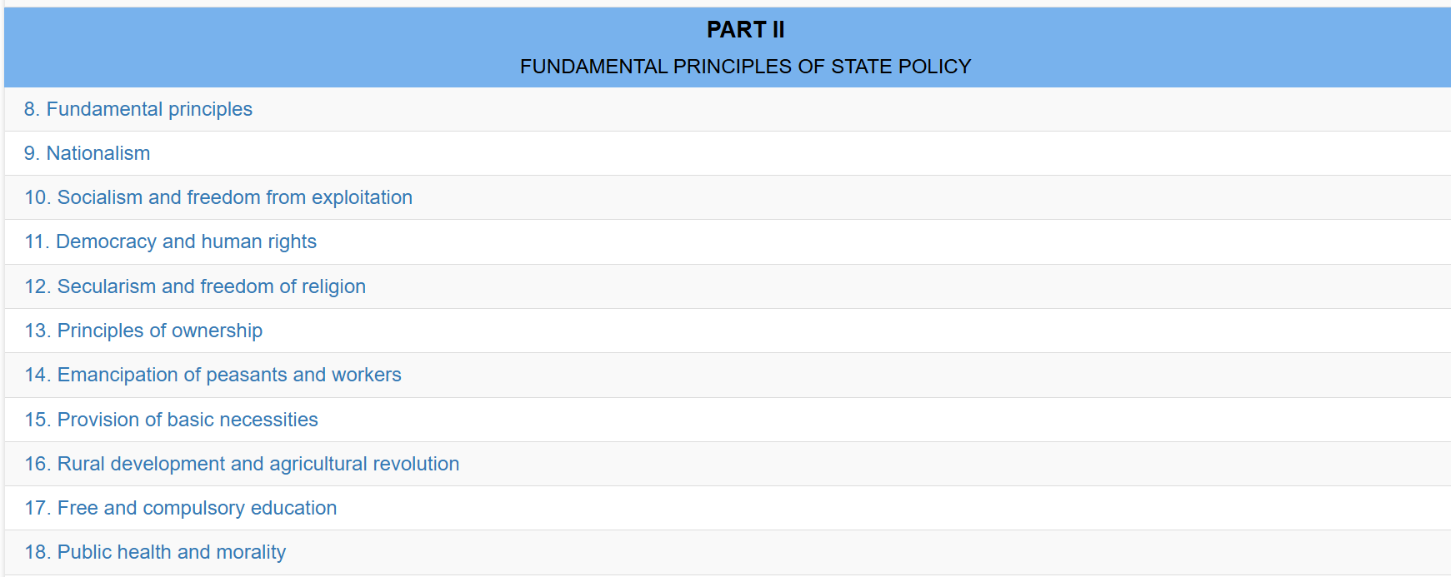

Slide 59
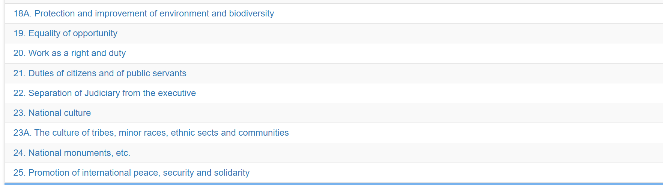

Slide 60
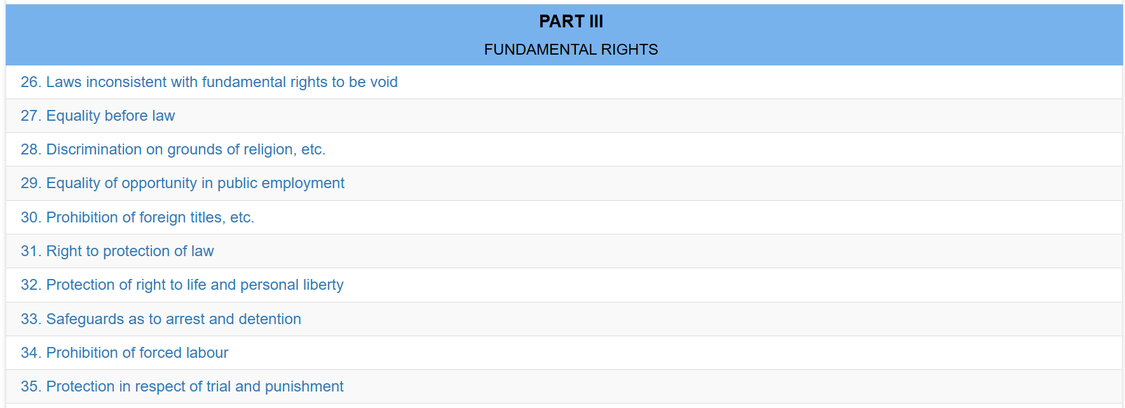

Slide 61
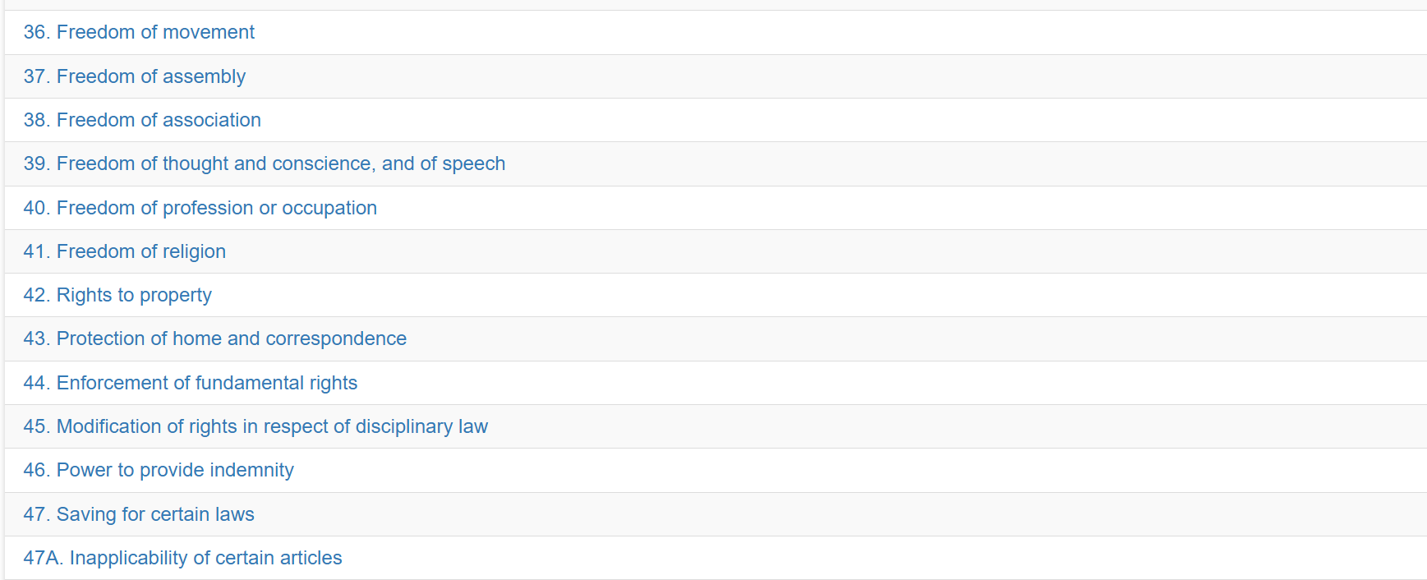

Slide 62
রাষ্ট্রপতি
রাষ্ট্রপতি
রাষ্ট্রপতির অভিশংসন
রাষ্ট্রপতির দায়মুক্তি
রাষ্ট্রপতি-পদের মেয়াদ
ক্ষমা প্রদর্শনের অধিকার
অসামর্থ্যের কারণে রাষ্ট্রপতির অপসারণ
অনুপস্থিতি প্রভৃতির-কালে রাষ্ট্রপতি-পদে স্পীকার

Slide 63
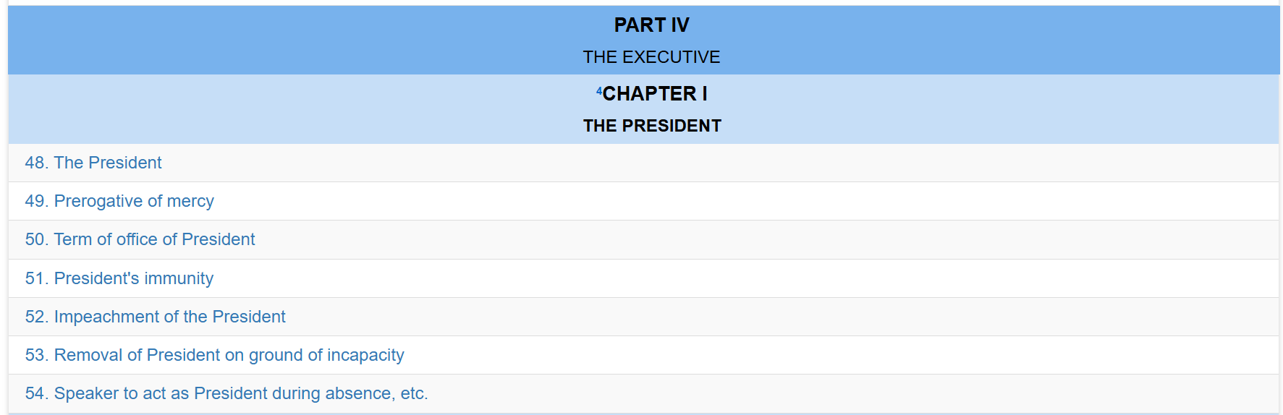

Slide 64
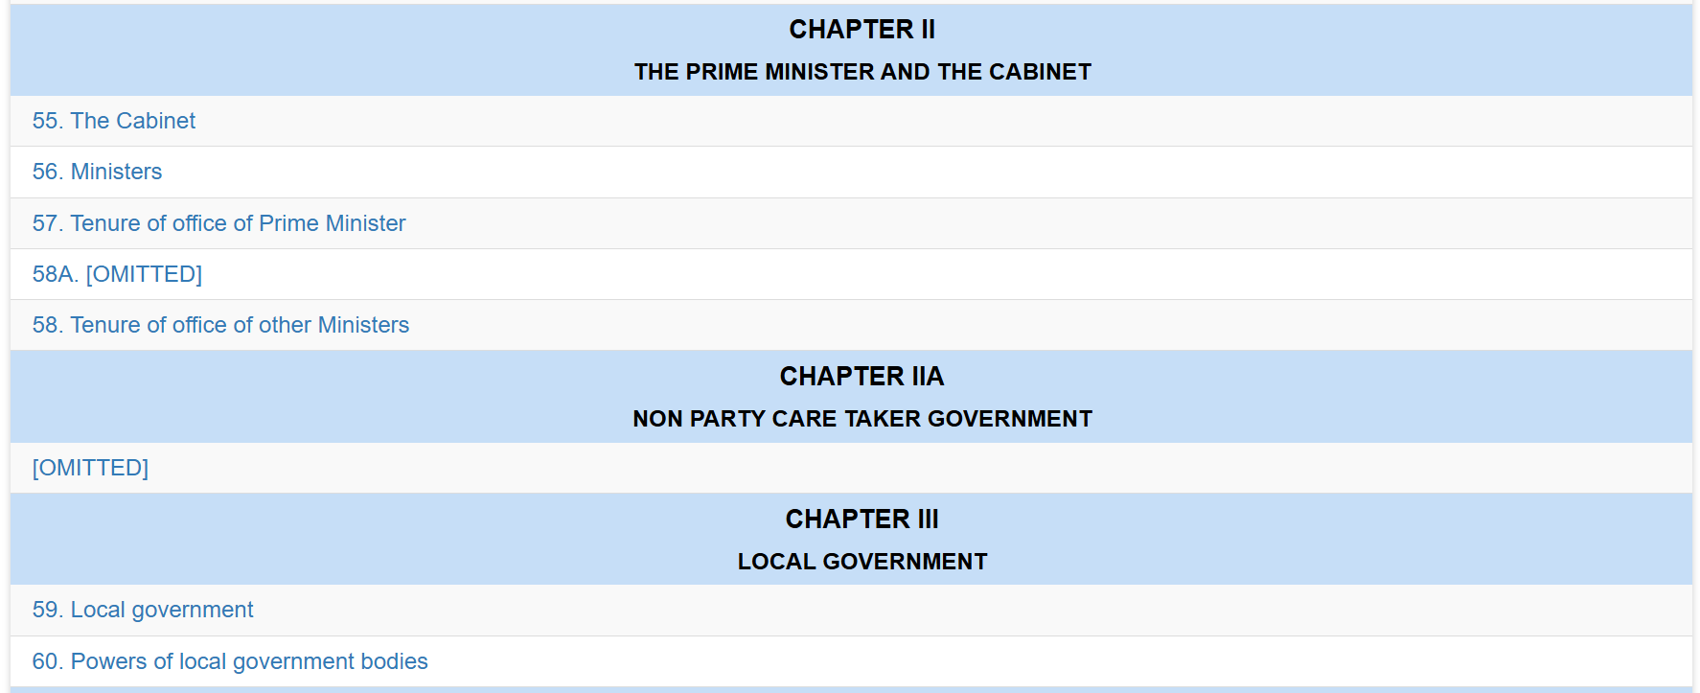

Slide 65
প্রধানমন্ত্রী ও মন্ত্রিসভা
অন্যান্য মন্ত্রীর পদের মেয়াদ
প্রধানমন্ত্রীর পদের মেয়াদ
মন্ত্রিগণ
মন্ত্রিসভা

Slide 66
LOCAL GOVERNMENT
Powers of local government bodies
Local government

Slide 67
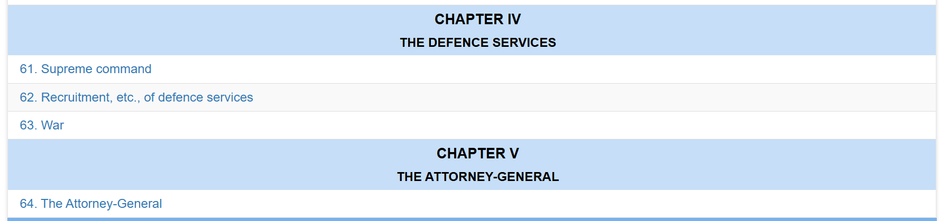

Slide 68
Recruitment, etc., of defence services
Supreme command

Slide 69
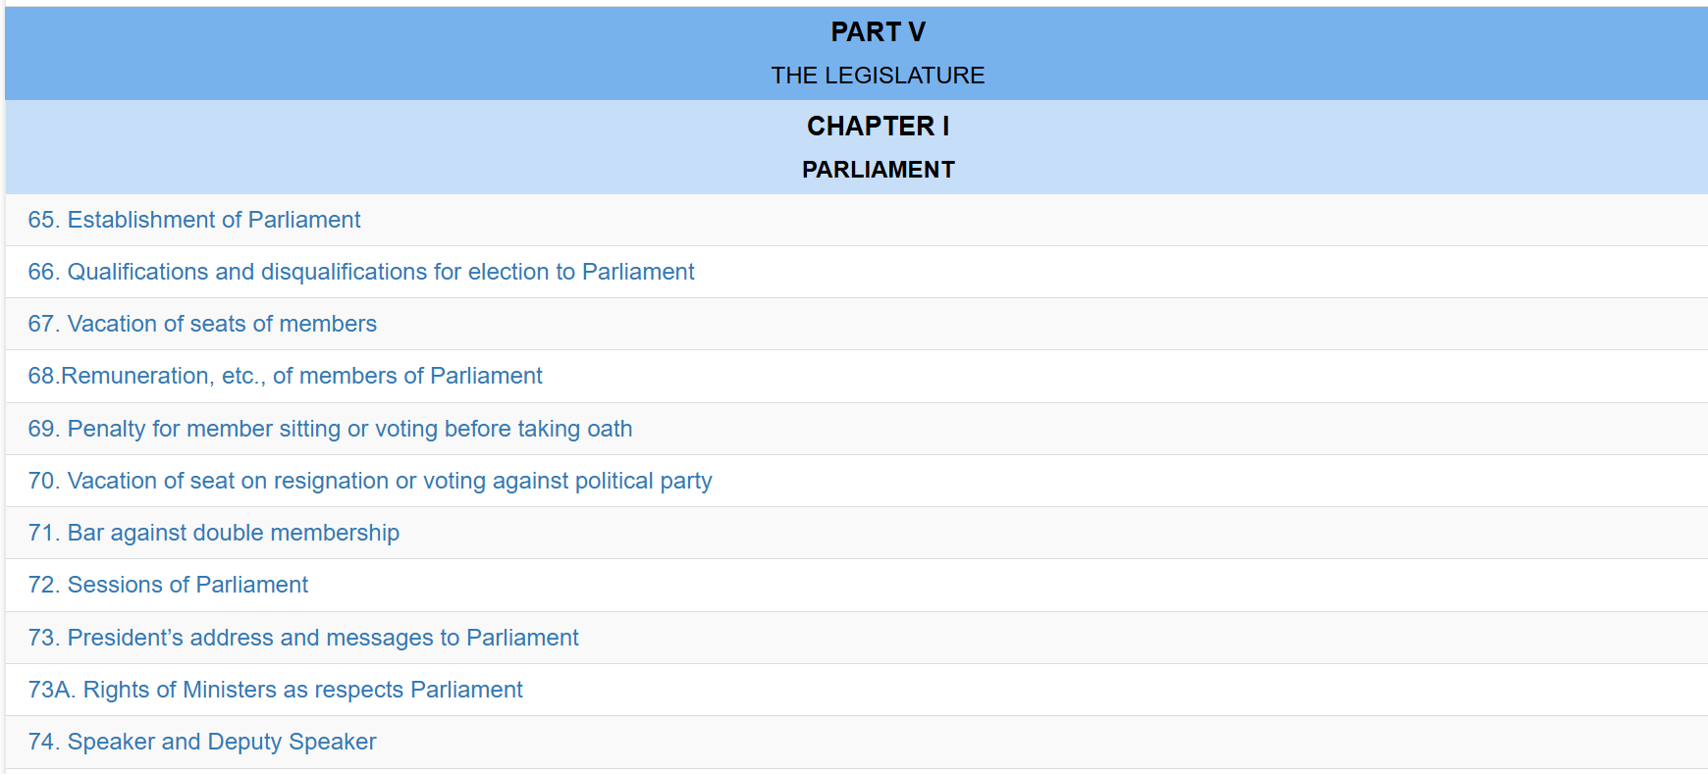

Slide 70
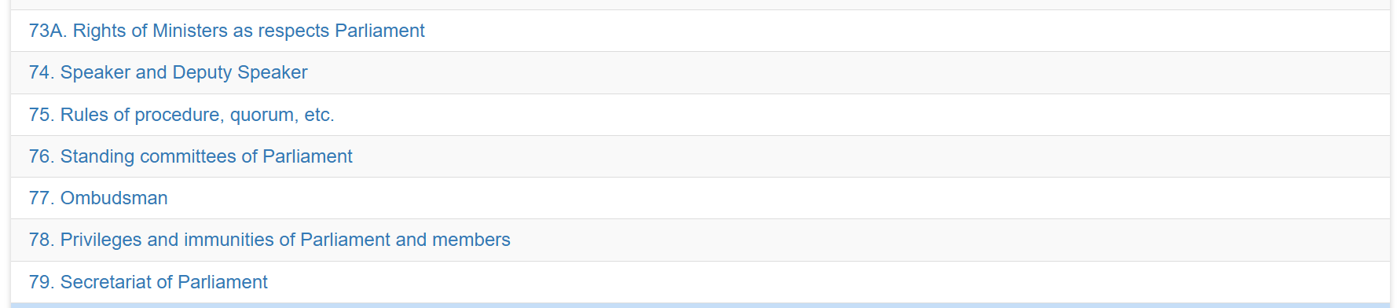

Slide 71
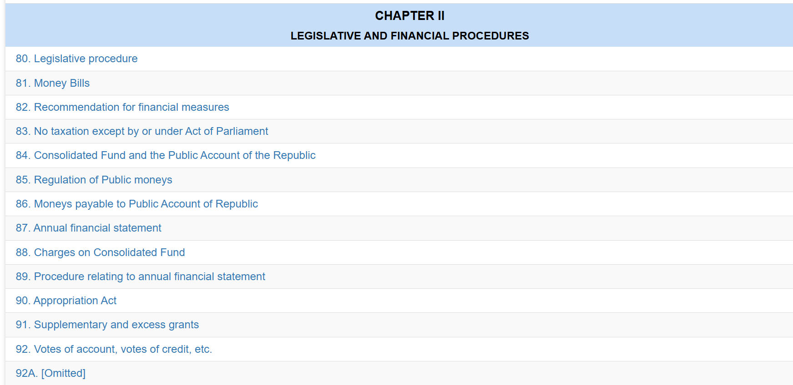

Slide 72
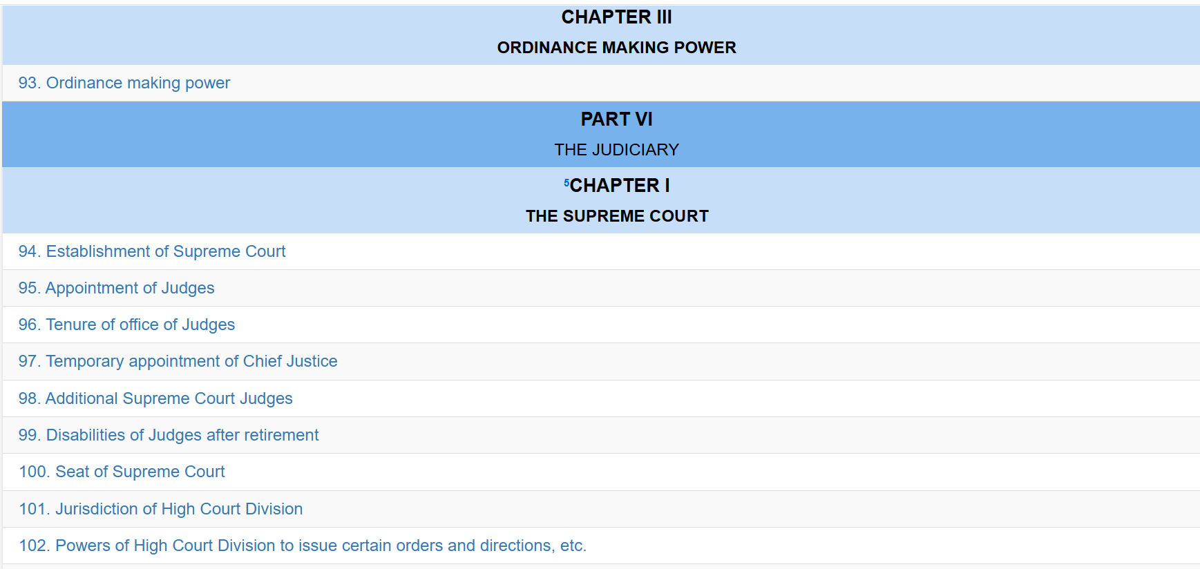

Slide 73
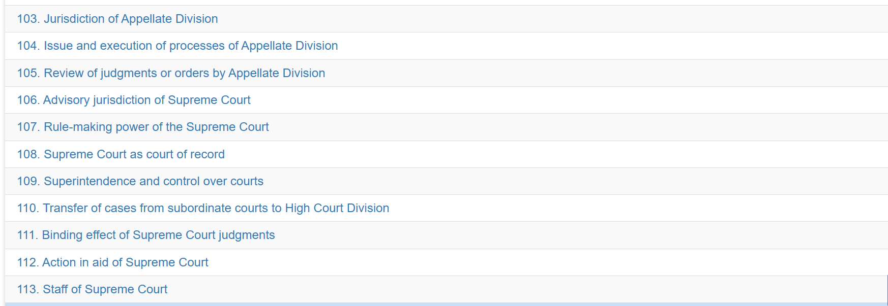

Slide 74


Slide 75


Slide 76


Slide 77


Slide 78
133
Appointment and conditions of service
134
Tenure of office
135
Dismissal, etc. of civilian public officers
136

Slide 79


Slide 80


Slide 81


Slide 82


Part II FUNDAMENTAL PRINCIPLES OF STATE POLICY
FR
FABRIKAM RESIDENCES

Slide 83

জাতীয়তাবাদ
সমাজতন্ত্র ও শোষণমুক্তি
গণতন্ত্র ও মানবাধিকার
ধর্ম নিরপেক্ষতা ও ধর্মীয় স্বাধীনতা
Fundamental principles
জাতীয়তাবাদ
সমাজতন্ত্র ও শোষণমুক্তি
গণতন্ত্র ও মানবাধিকার
ধর্ম নিরপেক্ষতা ও ধর্মীয় স্বাধীনতা

Slide 84


Slide 85


Slide 86


Slide 87


Slide 88


Slide 89


Slide 90


Slide 91


Slide 92


Slide 93


Slide 94


Slide 95


Slide 96


Slide 97


Slide 98


Slide 99


Slide 100


Slide 101


Slide 102
Part II
FUNDAMENTAL PRINCIPLES OF STATE POLICY
8. Fundamental principles
9. Nationalism
10. Socialism and freedom from exploitation
11. Democracy and human rights
12. Secularism and freedom of religion
13. Principles of ownership
14. Emancipation of peasants and workers
15. Provision of basic necessities
16. Rural development and agricultural revolution
17. Free and compulsory education
18. Public health and morality
18A. Protection and improvement of environment and biodiversity
19. Equality of opportunity
20. Work as a right and duty
21. Duties of citizens and of public servants
22. Separation of Judiciary from the executive
23. National culture
23A. The culture of tribes, minor races, ethnic sects and communities
24. National monuments, etc.
25. Promotion of international peace, security and solidarity

Slide 103

Part III
FUNDAMENTAL RIGHTS
26. Laws inconsistent with fundamental rights to be void
27. Equality before law
28. Discrimination on grounds of religion, etc.
29. Equality of opportunity in public employment
30. Prohibition of foreign titles, etc.
31. Right to protection of law
32. Protection of right to life and personal liberty
33. Safeguards as to arrest and detention
34. Prohibition of forced labour
35. Protection in respect of trial and punishment
36. Freedom of movement

Slide 104
Part IV
THE EXECUTIVE
⁴Chapter I
THE PRESIDENT
48. The President
49. Prerogative of mercy
50. Term of office of President
51. President's immunity
52. Impeachment of the President
53. Removal of President on ground of incapacity
54. Speaker to act as President during absence, etc.

Slide 105
Chapter II
THE PRIME MINISTER AND THE CABINET
55. The Cabinet
56. Ministers
57. Tenure of office of Prime Minister
58A. [OMITTED]
58. Tenure of office of other Ministers

Slide 106
Chapter IIA
NON PARTY CARE TAKER GOVERNMENT
[OMITTED]
Chapter III
LOCAL GOVERNMENT
59. Local government
60. Powers of local government bodies
Chapter IV
THE DEFENCE SERVICES
61. Supreme command
62. Recruitment, etc., of defence services
63. War

Slide 107

Chapter V
THE ATTORNEY-GENERAL
64. The Attorney-General
Part V
THE LEGISLATURE
Chapter I
PARLIAMENT
65. Establishment of Parliament
66. Qualifications and disqualifications for election to Parliament
67. Vacation of seats of members
68.Remuneration, etc., of members of Parliament
69. Penalty for member sitting or voting before taking oath
70. Vacation of seat on resignation or voting against political party
71. Bar against double membership

Slide 108
Chapter II
LEGISLATIVE AND FINANCIAL PROCEDURES
80. Legislative procedure
81. Money Bills
82. Recommendation for financial measures
83. No taxation except by or under Act of Parliament
84. Consolidated Fund and the Public Account of the Republic
85. Regulation of Public moneys
86. Moneys payable to Public Account of Republic
87. Annual financial statement
88. Charges on Consolidated Fund
89. Procedure relating to annual financial statement
90. Appropriation Act
91. Supplementary and excess grants
92. Votes of account, votes of credit, etc.
92A. [Omitted]

Slide 109

Chapter III
ORDINANCE MAKING POWER
93. Ordinance making power
Part VI
THE JUDICIARY
⁵Chapter I
THE SUPREME COURT
94. Establishment of Supreme Court
95. Appointment of Judges
96. Tenure of office of Judges
97. Temporary appointment of Chief Justice
98. Additional Supreme Court Judges
99. Disabilities of Judges after retirement
100. Seat of Supreme Court

Slide 110

Chapter II
SUBORDINATE COURTS
114. Establishment of subordinate courts
115. Appointments to subordinate courts
116. Control and discipline of subordinate courts
116A. Judicial officers to be independent in the exercise of their functions
Chapter III
ADMINISTRATIVE TRIBUNALS
117. Administrative tribunals

Slide 111

Part VIII
THE COMPTROLLER AND AUDITOR GENERAL
127. Establishment of office of Auditor-General
128. Functions of Auditor-General
129. Term of office of Auditor-General
130. Acting Auditor-General
131. Form and manner of keeping public accounts
132. Reports of Auditor General to be laid before Parliament

Slide 112
Chapter II
PUBLIC SERVICE COMMISSIONS
137. Establishment of commissions
138. Appointment of members
139. Term of office
140. Functions of commissions
141. Annual report
Part IXA
EMERGENCY PROVISIONS
141A. Proclamation of emergency
141B. Suspension of provisions of certain articles during emergencies
141C. Suspension of enforcement of fundamental rights during emergencies
Part X
AMENDMENT OF THE CONSTITUTION
142. Power to amend any provision of the Constitution

Slide 113
Part XI
MISCELLANEOUS
143. Property of the Republic
144. Executive authority in relation to property, trade, etc.
145. Contracts and deeds
145A. International treaties
146. Suits in name of Bangladesh
147. Remuneration, etc., of certain officers
148. Oaths of office
149. Saving for existing laws
150. Transitional and temporary provisions
151. Repeals
152. Interpretation
153. Commencement, citation and authenticity

Slide 114
Schedule
SCHEDULE
Appendix

Slide 115
BISMILLAH-AR-RAHMAN-AR-RAHIM
In the name of Allah, the Beneficient, the Merciful)/ In the name of the Creator, the Merciful.
PREAMBLE
We, the people of Bangladesh, having proclaimed our independence on the 26th day of March, 1971 and through ²[a historic struggle for national liberation], established the independent, sovereign People's Republic of Bangladesh;
Pledging that the high ideals of nationalism, socialism, democracy and secularism, which inspired our heroic people to dedicate themselves to, and our brave martyrs to sacrifice their lives in, the national liberation struggle, shall be the fundamental principles of the Constitution;
Further pledging that it shall be a fundamental aim of the State to realise through the democratic process a socialist society, free from exploitation a society in which the rule of law, fundamental human rights and freedom, equality and justice, political, economic and social, will be secured for all citizens;
Affirming that it is our sacred duty to safeguard, protect and defend this Constitution and to maintain its supremacy as the embodiment of the will of the people of Bangladesh so that we may prosper in freedom and may make our full contribution towards international peace and co operation in keeping with the progressive aspirations of mankind;
In our Constituent Assembly, this eighteenth day of Kartick, 1379 B.S., corresponding to the fourth day of November, 1972 A.D., do hereby adopt, enact and give to ourselves this Constitution.

Slide 116
Part II
FUNDAMENTAL PRINCIPLES OF STATE POLICY
Fundamental principles
8. (1) The principles of nationalism, socialism, democracy and secularism, together with the principles derived from those as set out in this Part, shall constitute the fundamental principles of state policy.
(2) The principles set out in this Part shall be fundamental to the governance of Bangladesh, shall be applied by the State in the making of laws, shall be a guide to the interpretation of the Constitution and of the other laws of Bangladesh, and shall form the basis of the work of the State and of its citizens, but shall not be judicially enforceable.
Nationalism
9. The unity and solidarity of the Bangalee nation, which, deriving its identity from its language and culture, attained sovereign and independent Bangladesh through a united and determined struggle in the war of independence, shall be the basis of Bangalee nationalism.
Socialism and freedom from exploitation
10. A socialist economic system shall be established with a view to ensuring the attainment of a just and egalitarian society, free from the exploitation of man by man.

Slide 117
Democracy and human rights
11. The Republic shall be a democracy in which fundamental human rights and freedoms and respect for the dignity and worth of the human person shall be guaranteed , and in which effective participation by the
people through their elected representatives in administration at all levels shall be ensured.
Secularism and freedom of religion
12. The principle of secularism shall be realised by the elimination of -
(a) communalism in all its forms ;
(b) the granting by the State of political status in favour of any religion ;
(c) the abuse of religion for political purposes ;
(d) any discrimination against, or persecution of, persons practicing a particular religion.

Slide 118
Principles of ownership
13. The people shall own or control the instruments and means of production and distribution, and with this end in view ownership shall assume the following forms –
(a) state ownership, that is ownership by the State on behalf of the people through the creation of an efficient and dynamic nationalised public sector embracing the key sectors of the economy;
(b) co operative ownership, that is ownership by co operatives on behalf of their members within such limits as may be prescribed by law; and
(c) private ownership, that is ownership by individuals within such limits as may be prescribed by law.

Slide 119
Emancipation of peasants and workers
14. It shall be a fundamental responsibility of the State to emancipate the toiling masses the peasants and workers and backward sections of the people from all forms of exploitation.
Provision of basic necessities
15. It shall be a fundamental responsibility of the State to attain, through planned economic growth, a constant increase of productive forces and a steady improvement in the material and cultural standard of living of the people, with a view to securing to its citizens –
(a) the provision of the basic necessities of life, including food, clothing, shelter, education and medical care;
(b) the right to work, that is the right to guaranteed employment at a reasonable wage having regard to the quantity and quality of work;

Slide 120
(c) the right to reasonable rest, recreation and leisure; and
(d) the right to social security, that is to say, to public assistance in cases of undeserved want arising from unemployment, illness or disablement, or suffered by widows or orphans or in old age, or in other such cases.

Slide 121
Rural development and agricultural revolution
16. The State shall adopt effective measures to bring about a radical transformation in the rural areas through the promotion of an agricultural revolution, the provision of rural electrification, the development of cottage and other industries, and the improvement of education, communications and public health, in those areas, so as progressively to remove the disparity in the standards of living between the urban and the rural areas.
Free and compulsory education
17. The State shall adopt effective measures for the purpose of –
(a) establishing a uniform, mass oriented and universal system of education and extending free and compulsory education to all children to such stage as may be determined by law;
(b) relating education to the needs of society and producing properly trained and motivated citizens to serve those needs;
(c) removing illiteracy within such time as may be determined by law.

Slide 122
Public health and morality
18. (1) The State shall regard the raising of the level of nutrition and the improvement of public health as among its primary duties, and in particular shall adopt effective measures to prevent the consumption, except for medical purposes or for such other purposes as may be prescribed by law, of alcoholic and other intoxicating drinks and of drugs which are injurious to health.
(2) The State shall adopt effective measures to prevent prostitution and gambling.
Protection and improvement of environment and biodiversity
18A. The State shall endeavor to protect and improve the environment and to preserve and safeguard the natural resources, bio-diversity, wetlands, forests and wild life for the present and future citizens.

Slide 123
Equality of opportunity
19. (1) The State shall endeavour to ensure equality of opportunity to all citizens.
(2) The State shall adopt effective measures to remove social and economic inequality between man and man and to ensure the equitable distribution of wealth among citizens, and of opportunities in order to attain a uniform level of economic development throughout the Republic.
¹⁸[(3)The State Shall endeavour to ensure equality of opportunity and participation of women in all spheres of national life.]
Work as a right and duty
20. (1) Work is a right, a duty and a matter of honour for every citizen who is capable of working, and everyone shall be paid for his work on the basis of the principle “from each according to his abilities, to each according to his work”.
(2) The State shall endeavour to create conditions in which, as a general principle, persons shall not be able to enjoy unearned incomes, and in which human labour in every form, intellectual and physical, shall become a fuller expression of creative endeavour and of the human personality.

Slide 124
Duties of citizens and of public servants
21. (1) It is the duty of every citizen to observe the Constitution and the laws, to maintain discipline, to perform public duties and to protect public property.
(2) Every person in the service of the Republic has a duty to strive at all times to serve the people.
Separation of Judiciary from the executive
22. The State shall ensure the separation of the judiciary from the executive organs of the State.
National culture
23. The State shall adopt measures to conserve the cultural traditions and heritage of the people, and so to foster and improve the national language, literature and the arts that all sections of the people are afforded the opportunity to contribute towards and to participate in the enrichment of the national culture.

Slide 125
The culture of tribes, minor races, ethnic sects and communities
23A. The State shall take steps to protect and develop the unique local culture and tradition of the tribes, minor races, ethnic sects and communities.]
National monuments, etc.
24. The State shall adopt measures for the protection against disfigurement, damage or removal of all monuments, objects or places of special artistic or historic importance or interest.

Slide 126
Promotion of international peace, security and solidarity 25. The State shall base its international relations on the principles of respect for national sovereignty and equality, non interference in the internal affairs of other countries, peaceful settlement of international disputes, and respect for international law and the principles enunciated in the United Nations Charter, and on the basis of those principles shall – (a) strive for the renunciation of the use of force in international relations and for general and complete disarmament; (b) uphold the right of every people freely to determine and build up its own social, economic and political system by ways and means of its own free choice; and (c) support oppressed peoples throughout the world waging a just struggle against imperialism, colonialism or racialism.

